Slide 1


P.S.V COLLEGE OF ENGINEERING AND TECHNOLOGY
(Approved by AICTE, New Delhi & Affiliated to Anna University, Chennai)
Accredited by NACC with ‘A’ Grade
(Inclusion Under Section 2(f) & 12(B) of the UGC Act, 1956) (AN ISO 9001:2015 certified Institution)
Bangalore - Chennai Highway, (NH- 46),
Mittapalli, Balinayanapalli Post, Krishnagiri -635 108.
DEPARTMENT OF ELECTRONICS AND COMMUNICATION ENGINEERING
DESIGN AND IMPLEMENTATION OF SECURED E-VOTING MACHINE USING OPENCV WITH DEEP LEARNING
TEAM MEMBERS:
DHYALAN C ( 611819106009 )
KARTHICK S ( 611819106016 )
SATHISH G ( 611819106046 )
PROJECT GUIDE:
Prof. PRAKASAM L
AP/ECE

Slide 2
OBJECTIVE
Our goal is to create a secure electronic voting machine that ensures the privacy, accuracy, and accessibility of the voting process, while minimizing the risk of tampering or fraud.
The system will be user-friendly, incorporating strong security features such as authentication, to ensure the reliability and transparency of the voting process.
We aim to provide a dependable and efficient solution that strengthens the trust in our democratic system.

Slide 3
ABSTRACT
Electronic Voting (E-voting) systems are gaining more attention in today's world due to their efficiency, speed, and convenience.
In this project, we propose a design and implementation of a Secured E-Voting Machine that utilizes RFID, fingerprint sensing, face recognition, and GSM technologies to ensure a reliable and secure voting process.
The proposed system is designed to be user-friendly, with a simple and intuitive interface that allows voters to cast their votes easily and securely.
The RFID technology is used to authenticate the voter's identity, while fingerprint sensing and face recognition are used to verify the authenticity of the voter.
The system also utilizes GSM technology to transmit message to person mobile number, providing real-time results while ensuring the transparency of the voting process.

Slide 4
SCOPE OF THE PROJECT:
The main aim of the project is to eliminate the security compromises in the existing voting system by introducing various authentication steps and communication between voter and election commission (Biometric, Face recognition, IOT,RFID and GSM).
For providing secured voting process.

Slide 5
Literature Survey
S. NO | YEAR | AUTHOR | TITLE | CONTENT
1 | 2020 | A.BalaMurali Potru Sarada Sravanthi B. Rupa, | Smart and Secure Voting Machine using Biometrics | This paper has a double verification for a more secure system. There is additional GPS in to prevent the system from theft if the system is stolen it can be located easily and immediately through satellites. Through GSM, we can get a confirmation message about to which candidate.
2 | 2021 | K. Anna purna V. Chandrani P Mounika P Teja Sree | Design of Authenticated Radio Frequency Identification based Electronic Voting Machine | Each voter will be given a unique RFID tag, which should be carried out to the polling booth while coming to cast their vote. Based on that, the EVM can easily identify the person is authenticated voter or not and also checks whether he/she had already voted or not.

Slide 6
EXISTING METHOD | PROPOSED METHOD
Votes are casted by just pressing a button. It does not have security features. Fingerprint sensing. RFID reader and card Drawbacks of existing system Casting false votes are possible. Finding Non-eligible candidates is difficult. In today method doesn’t provide the security. | Votes are cast using fingerprints. RFID reader and card The face identification using deep learning give the extra security protection for the voting machine. GSM module Advantages of proposed system No chance of casting false votes. Only the eligible candidates can caste vote. Four level security give the more responsible for the security losses.

Slide 7
HARDWARE REQUIREMENT
ARDUINO MEGA
POWER SUPPLY
FINGERPRINT SENSOR
GSM
RFID READER
RFID TAG
KEY PAD
LCD
IOT MODULE

Slide 8
SOFTWARE REQUIREMENT
ARDUINO IDE
EMBEDDED C
JUPITER NOTEBOOK

Slide 9
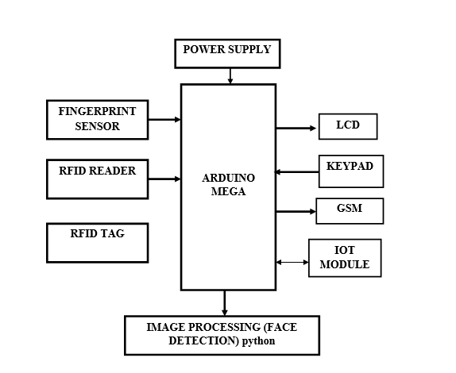
BLOCK DIAGRAM

Slide 10
BLOCK DIAGRAM DESCRIPTION
In our system, we have Arduino mega microcontroller which acts as brain of our system,
Hence entire system program is stored in it. Initially each voter has unique ID i.e. RFID which is accessed by reader.
Then he/she has to show the face in front of the camera if that ID and face matched means the voter have to place the finger for final authentication.
After that, they have to type it through keypad, then they can vote for favorable candidate by keypad.
At the end of the voting process they will receive message to his/her registered mobile number via GSM.
The IoT module is used to monitor the voting status and control the voting machine.

Slide 11
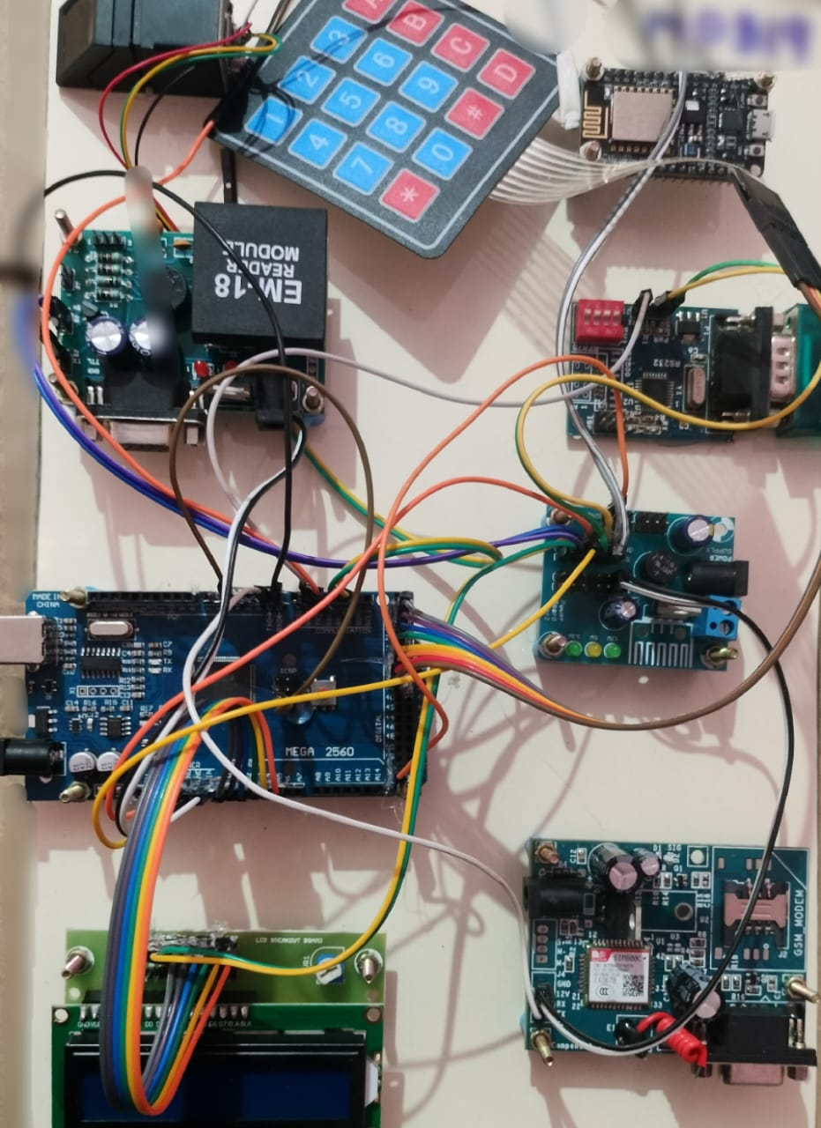
CIRCUIT

Slide 12
CIRCUIT DISCRIPTION
Arduino Mega 2560 : a microcontroller board which 54 digital input/output pins (of which 15 can be used as PWM outputs), 16 analog inputs, 4 UARTs (hardware serial ports), a 16 MHz crystal oscillator, a USB connection, a power jack, an ICSP header, and a reset button.
LinkSprite GSM/GPRS module: a miniature, single-side board, quad-band GSM 850/EGSM 900/DCS 1800/PCS 1900 module, ready for integration in various kinds of Fix wireless phones and other wireless devices.
EM-18 RFID Reader module: Operating at 125kHz and powered up with a 5V power supply.
Keypad: 4*4 matrix keypad connected to two ports.

Slide 13
R305 Fingerprint Module: Consists of optical fingerprint sensor, high-speed DSP processor, high-performance fingerprint alignment algorithm, high-capacity FLASH chips.
LCD Display: 16x2 LCD display
R305 Fingerprint Module: Consists of optical fingerprint sensor, high-speed DSP processor, high-performance fingerprint alignment algorithm, high-capacity FLASH chips.
ESP-12E Wi-Fi module: Core processor ESP8266 in smaller sizes of the module encapsulates Tensilica L106 integrates industry-leading ultra-low power 32-bit MCU micro, with the 16-bit short mode, Clock speed support 80 MHz .
POWER SUPPLY : 0-12V/1 mA transformer is used.
RS-232: Serial communication device between computer and the microcontroller for data exchange. Use 5v power supply.

Slide 14
WORKING PRINCIPLE……

Slide 15
ELECTION OFFICER AUTHENTICATION:
In this voting system, the first with the use of a webpage the election officer initiates the start of the election.
The prototype provided is activated by the command from the webpage which is given by the officer.
The command from the webpage is received by the microcontroller (Arduino MEGA) and the voting process is initiated, this process is followed by the RFID authentication.
POWER SUPPLY
IOT MODULE
ARDUINO
MEGA
LCD

Slide 16
RFID AUTHENTICATION :
The polling officers with their RFID tag ensures their identity and they are asked for their biometric for security reasons.
The voter ID which is linked with the voter data is a RFID tag by which the voters can ensure their identification in the polling booths.
The LCD attached shows the process of the model.
POWER SUPPLY
RFID READER
ARDUINO
MEGA
LCD
RFID TAG

Slide 17
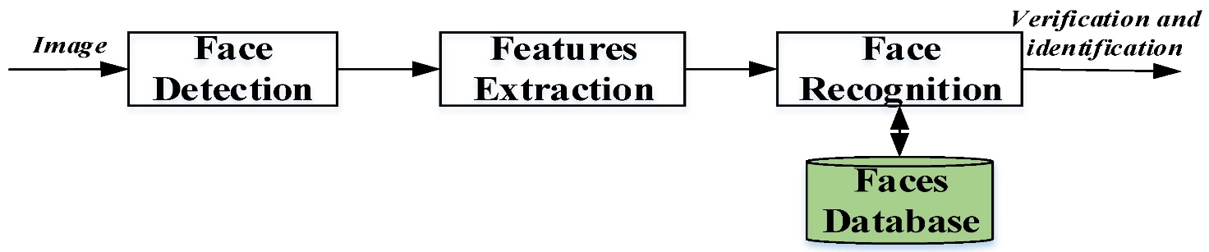
FACE AUTHENTICATION:
The face authentication is one of the feature where the security is enhanced.
The voter face is ensured by detecting face through the camera placed in the machine and identify the face by matching face data which is saved in the database with help of OpenCV and face recognition library packages.
OpenCV is a library which supports deep learning based tasks by introducing a new module called DNN (Deep Neural Networks).
This DNN module was designed to make it easy to integrate deep learning models that have already been trained.

Slide 18
BIOMETRIC AUTHENTICATION:
The polling officer in the booth ensures their identity by RFID followed by their biometric when again activates the prototype after the IOT authentication by the election officer.
The voters also ensures their identity by the RFID and followed by their biometric to cast their votes.
POWER SUPPLY
FINGERPRINT SENSOR
ARDUINO
MEGA
LCD

Slide 19
VOTE CASTING:
After all the above verification process the voters can cast their votes using the Keypad and a SMS is sent to the voters mobile number.
All these process are displayed in the LCD.
POWER SUPPLY
KEYPAD
ARDUINO
MEGA
LCD
GSM

Slide 20
ADVANTAGES
Less manpower needed.
Only the eligible candidates can caste vote.
Votes are cast after different various authentication processes.

Slide 21
FUTURE ENHANCEMENT
This system can be connected in cloud, so that all the polling booths operation are monitored through authorised personnel’s.
In future polling can be done online by implementing various security measures which can be convenient for the voters.
We can use blockchain technology, the data of person are able to convert into the keys for hiding the data and it not able to alter or change externally.

Slide 22
CONCLUSION
The main outcome of this project is to improve the security in the voting system.
The security improvement is attained by the various authentication processes
The election officer and the polling officer are given separate authentication to start the polling process.
By all the above processes the security has been increased in the voting system.

Slide 23
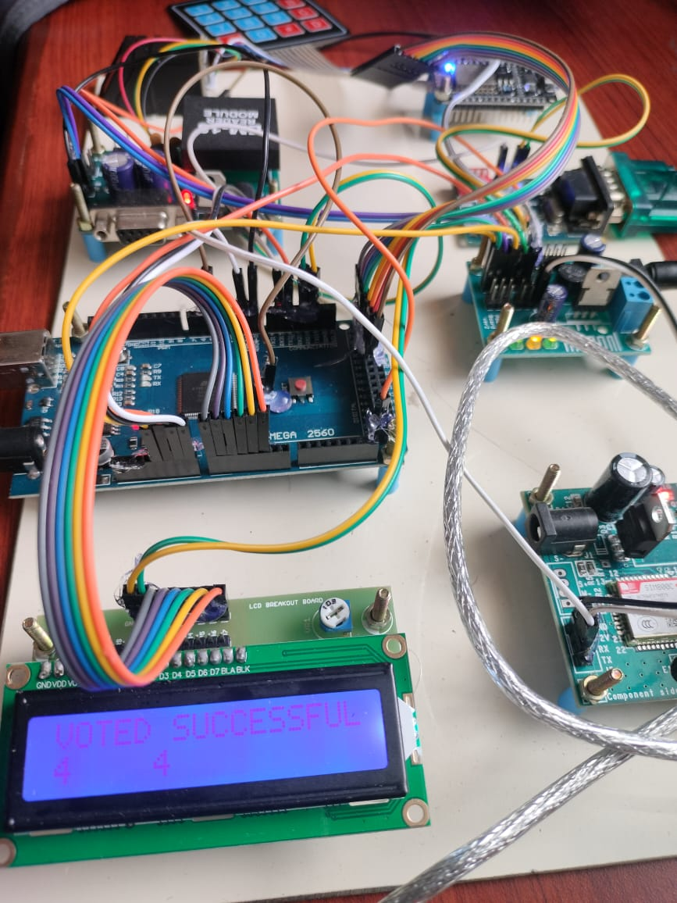
RESULT

Slide 24
REFERENCES:
1. D. Ashok Kumar, T. Ummal Sariba Begum, Proceedings of the International Conference on Pattern Recognition, Informatics and Medical Engineering, March 21-23, 2012. "Electronic Voting Machine – A Review."
2. Ankita R. kasliwal, Jaya S. Gadekar, Manjiri A. Lavadkar, Pallavi K. Thorat, Dr. Prapti Desmukh,”Aadhar Based Election Voting Syestem” ,IOSR- Journal of Computer and Engineering),[p-ISSN2394-9333],PP 18-21.
3. Thiruthanigesan Kanagasabai et al,”Fingerprint voting system using Arduino,Middle-East Journal of Scientific Research,25 (8): 1793-1802,2017.
4 N.N.Nagamma and et al. “Aadhar based fingerprint EVM system”, International Journal of Electronics Engineering Research,ISSN 0975- 6450 vol.9,No.6(2017) pp. 923-930.
5. Deepika Iswarya, Rathna Prabha, Trini Xavier, "A Survey on E-Voting System Using Arduino Software", International Journal of Advanced Research in Electrical Electronics and Instrumentation Engineering (An ISO 3297: 2007 Certified Organization), vol. 5, no. 2, pp. 687-690, February 2016.

Slide 25
6. D. Bowen. \Top-to-Bottom" Review (TTBR) of voting machines certified for use in California. California Secretary of State, Aug. 2007. http://sos.ca.gov/elections/elections vsr.htm.
7. J. Brunner. Evaluation & Validation of Election-Related Equipment, Standards & Testing (EVEREST). Ohio Secretary of State, Dec. 2007. http://www.sos.state.oh.us/SOS/Text.aspx?page=4512.
8. Bundesverfassungsgericht (German Constitutional Court). Judgment [...] 2 BvC 3/07, 2 BvC 4/07, o_cial English translation. Mar. 3, 2009. http://www.bverfg.de/ entscheidungen/rs20090303 2bvc000307en.html.
9. K. Butler, W. Enck, H. Hursti, S. McLaughlin, P. Traynor, and P. McDaniel. Systemic issues in the Hart InterCivic and Premier voting systems: Reections on Project EVEREST. In Proc. EVT, San Jose, CA, July 2008.
10. J. A. Calandrino, A. J. Feldman, J. A. Halderman, D. Wagner, H. Yu, and W. P. Zeller. Source code review of the Diebold voting system. Part of California TTBR, Aug. 2007.

